Slide 1
Budget Wise AI Expense Forecasting Tool
Presented by TEAM-C
KAVYA SAMPATHIRAO
KOKILA M
NANDI MANGALAM GEERVANI
POOLASETTY CHANDANA
PRATYASHA BASAK
PRIYANSHI JAYANT

Slide 2
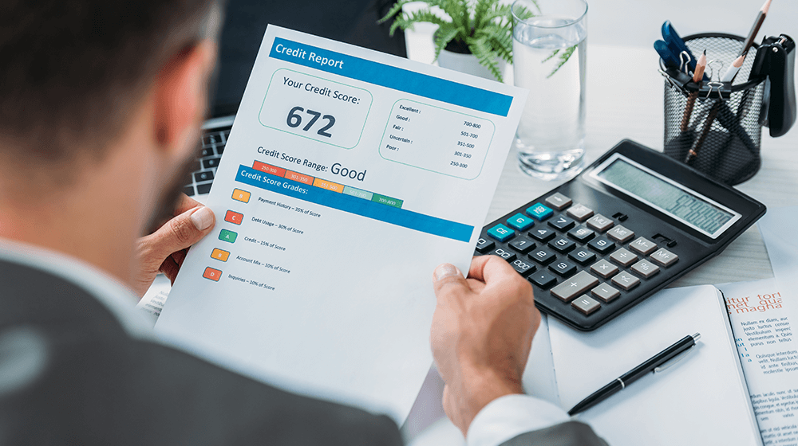
CONTENTS
ABSTRACT
INTRODUCTION
PROBLEM STATEMENT
OUR SOLUTION (OVERVIEW)
METHODOLOGY
TARGET USERS & USE CASES
CONCLUSION

Slide 3
ABSTRACT
Managing money wisely is a challenge for many individuals and businesses. Our project, Budget Wise – an AI-Based Expense Forecasting Tool, aims to simplify financial planning by using Artificial Intelligence to analyze past spending habits and predict future expenses. By understanding how and where money is spent, the system helps users create smarter budgets, avoid overspending, and make informed financial decisions. With personalized insights and predictions, Budget

Slide 4

INTRODUCTION
An AI-Based Expense Forecasting Tool is a smart system that uses Artificial Intelligence to analyze past spending patterns and predict future expenses.
It goes through all your old spending records – how much you spent on groceries, bills, fun stuff, etc.
Both individuals (like you!) and businesses can use it to manage their money better.

Slide 5
PROBLEM STATEMENT
Struggle with Budgeting: Many find it hard to create and stick to budgets because they can't predict future spending. This leads to overspending and financial stress.
Manual Tracking Issues: Recording expenses by hand is slow, error-prone, and often incomplete. It wastes time and gives an unclear picture of finances.
No Smart Forecasting: Existing tools don't intelligently predict future costs based on spending habits. This leaves financial planning reactive instead of proactive.

Slide 6
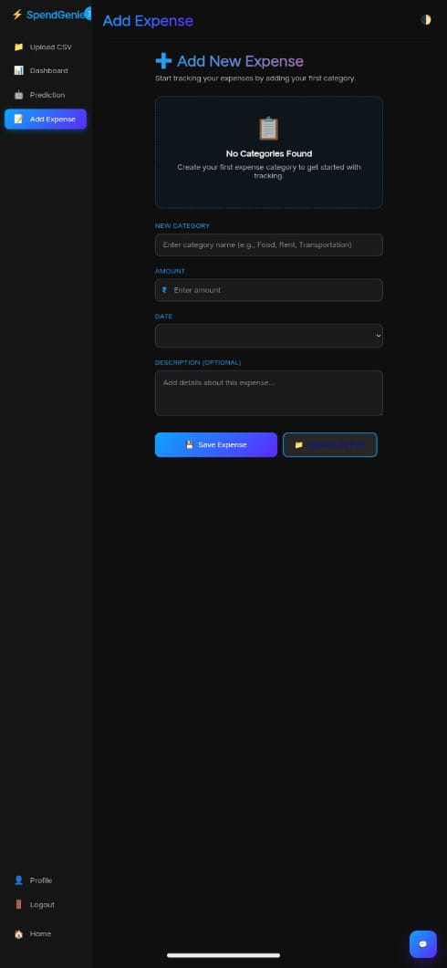
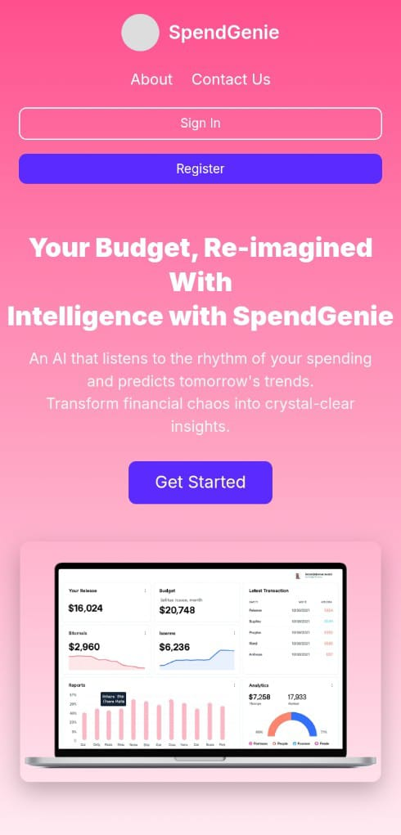
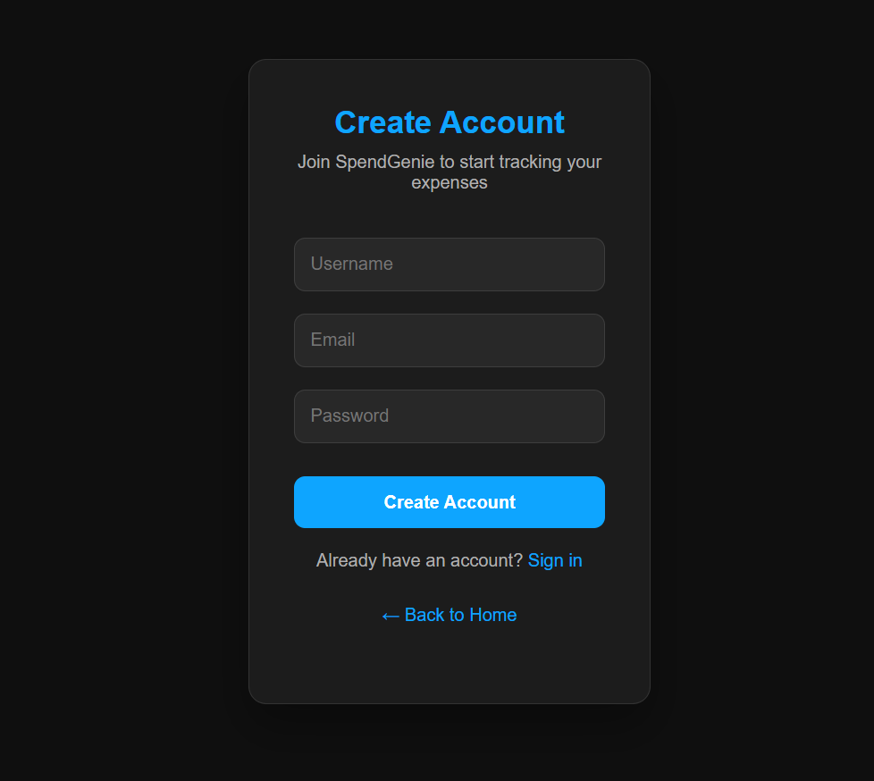
OUR SOLUTION

Slide 7
METHODOLOGY
Data Collection:
Acquire personal finance expense dataset from reliable sources (e.g., Kaggle).
Data Preprocessing:
Clean missing values, format date and category fields, and normalize data.
Feature Engineering:
Extract key features such as monthly totals, category averages, and trends.
Model Development:
Train AI/ML models (e.g., Linear Regression, LSTM, or Prophet) for expense forecasting.
Budget Categorization:
Divide expenses into user-defined categories (Food, Travel, Bills, etc.) and compare with budget limits.
Visualization & Insights:
Generate graphs showing past and predicted expenses for smarter financial planning.
User Interface:
Design an interactive dashboard or tool for visualization and input.

Slide 8

The way to get started is to quit talking and begin doing.
TARGET USERS & USE CASES
Walt Disney

Slide 9
Target Users Individuals managing personal finances. Students and young professionals tracking expenses. Families planning monthly budgets. Small business owners monitoring cash flow. Use Cases Predicting monthly or weekly expenses. Generating budget recommendations per category. Sending alerts for overspending. Analyzing spending trends for better financial decisions.

Slide 10
TECH STACK
🛠 Tech Stack
Frontend: HTML5, CSS3, JavaScript, Plotly.js (interactive charts), Responsive UI, Theme Toggle
Backend: Python Flask, Flask-SQLAlchemy (ORM), Flask-Bcrypt (Auth), Session Management
Machine Learning: Scikit-Learn (Linear Regression), Pandas & NumPy (data cleaning + preprocessing)
Database: SQLite (User accounts, transaction data)
Utilities: PyNgrok (public runtime exposure), UUID-based secure file handling
🚀 Deployment Architecture
Runs on Flask server with per-user session isolation
CSV uploaded → validated → cleaned → stored in secure sandbox directories
ML model processes historical pattern → generates predictions & insights
Visual analytics rendered via Plotly.js in browser
Integrated AI chatbot for personalized feedback using stored spending history
Uses Ngrok tunnel for remote secure access (dev-ready; cloud deployable future stage)
🔐 Security
Password hashing (Bcrypt)
Isolated file storage per user
Prevents cross-account data leaks
DEPLOYMENT

Slide 11

CONCLUSION
Budget Wise makes money management smarter and easier by using AI to analyze spending habits and predict future expenses.
It helps users plan budgets, control spending, and make better financial decisions with clear insights and visual reports.
By combining data analysis and interactive dashboards, the tool encourages smarter saving and financial awareness. In short, Budget Wise is a step toward stress-free and intelligent financial planning for everyone.

Slide 12


